Slide 1
MAGNETOSTATIC FIELDS

Slide 2
Magnetostatics is the branch of electromagnetics dealing with the effects of electric charges in steady motion (i.e, steady current or DC).

Slide 3
There are two major laws governing magnetostatic fields:
(1) Biot-Savart's law
(2) Ampere's circuit law

Slide 4
BIOT-SAVART'S LAW
Biot-Savart's law states that the magnetic field intensity dH produced at a point P by the differential current clement IdI is proportional to the product Idl and the sine of the angle between the clement and the line joining P to the element and is inversely proportional to the square of the distance R between P and the element.

Slide 5
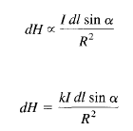
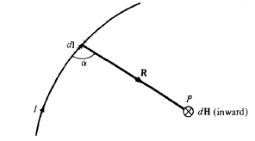


where k is the constant of proportionality. In SI units, k = l/4pi

Slide 6

AMPERE'S CIRCUIT LAW
Ampere's circuit law states that the line integral of the tangential component of H around a closed path is the same as the net current enclosed by the path.

Slide 7

Ampere's law is similar to Gauss's law and it is easily applied to determine H when the current distribution is symmetrical.

Slide 8


MAGNETIC FLUX DENSITY
The magnetic flux density B is similar to the electric flux density D.
The magnetic flux density B is related to the magnetic field intensity H according to
The magnetic flux through a surface S is given by

Slide 9
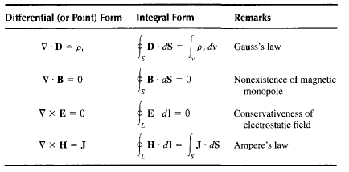
MAXWELL'S EQUATIONS FOR STATIC EM FIELDS

Slide 10
END

